Slide 1

M5 – Visual Recognition
Project: Cross-modal Retrieval
Week 5: Cross-modal Image Retrieval
​
Group 3: Guillem Capellera, Abel García, Johnny Nuñez and Anna Oliveras
Notes:
My name is
What?
My name is
Who?
My name is
Chika-chika
Slim Shady

Slide 2
Tasks week 5
a. Implement basic Image-to-text retrieval.
b. Implement basic Text-to-image retrieval.
c. Use BERT embedding as Text feature extractor.
d. Review the report with the provided feed-back
e. Prepare final presentation

Slide 3
Environment

Slide 4
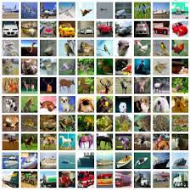
Dataset: COCO 2014 [1]
The COCO (Common Objects in Context) dataset is a widely used benchmark for object detection, instance segmentation, and other computer vision tasks. It contains images of everyday scenes that are annotated with object instance masks, object bounding boxes, and object categories.
The training set contains approximately 82,000 images with over 200,000 labeled objects, while the validation set contains around 40,000 images with over 100,000 labeled objects. Each image has 5 captions associated with it.
For the different tasks we use the following random subsets:
→ Train: All the training images (approximately 82.000)
→ Validation: last 100 images of the validation set of COCO
→ Test: 1000, 500 and 100 first images of the validation set of COCO

Slide 5
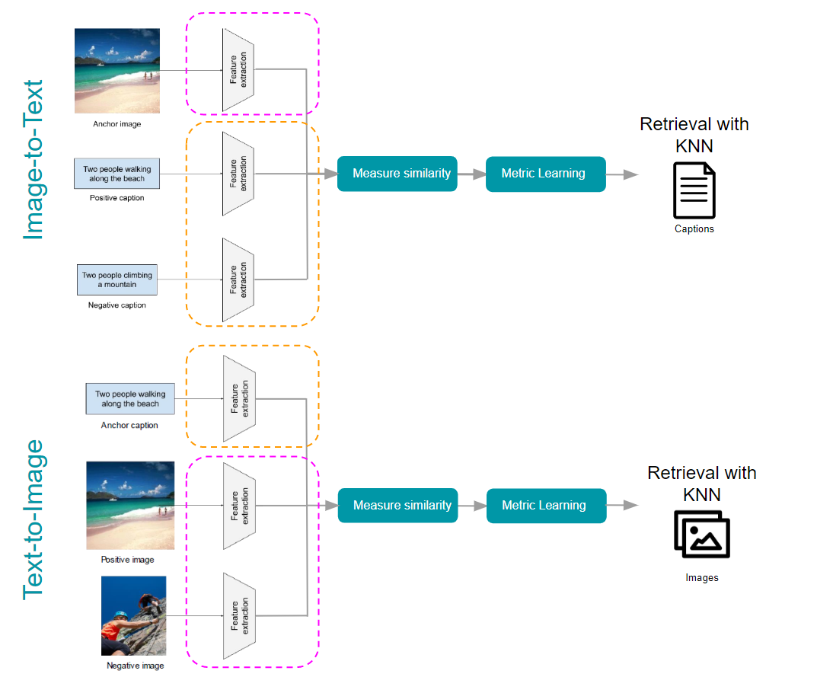
Language and Image Stream
Either for the Image-To-Text and the Text-To-Image we will have two streams: the language and the image stream.
Image stream:
In task a,b,c we compare the usage of the following networks:
Faster R-CNN [2] pretrained with COCO 2017 [1] dataset
ResNet 50 [3] pretrained with IMAGENET dataset [4]
Language Stream:
Task a and b with FastText [5]
Task c with BERT [6]

Slide 6

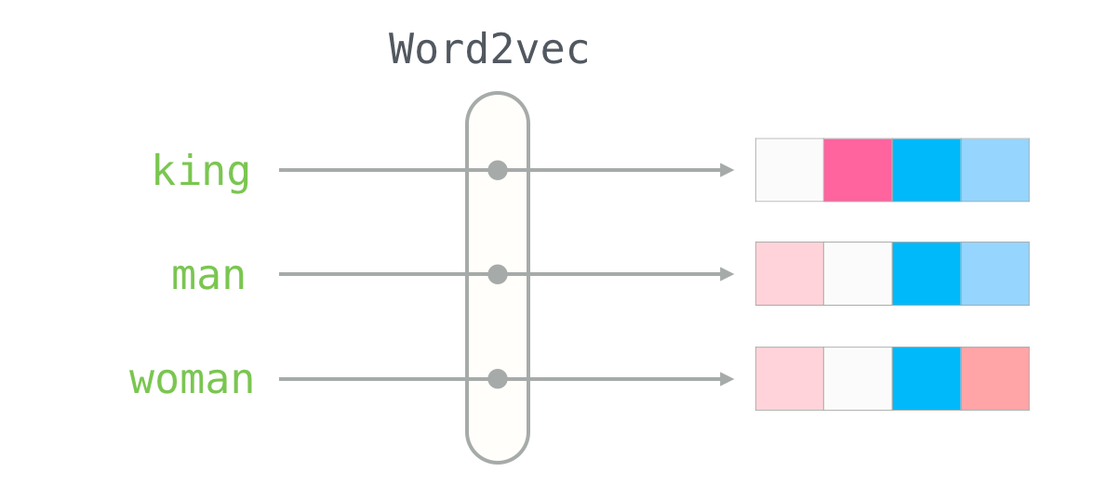
Language Stream: FastText
FastText [5] → extends the Word2Vec algorithm by incorporating additional information from character n-gram ( adds a character-level embedding component).
Word2vec
Consists of two models: Continuous Bag-of-Words (CBOW) and Skip-Gram
Learns word embeddings by predicting a target word from its surrounding context words
CBOW predicts the target word from its context, while Skip-Gram predicts the context words from the target word
FastText
Breaks words into smaller subword units called character n-grams
Each word is represented as a bag of character n-grams
Helps capture morphological information such as prefixes and suffixes
Builds upon the CBOW model used in Word2Vec
Notes:
FasText trata de capturar la información morfológica de las palabras.
De esta manera, una palabra quedará representada por sus n-gramas. El tamaño de los n-gramas deberá definirse como hiperparámetro:
min_n: el valor mínimo de n a considerar.
max_n: el valor máximo de n a considerar. https://amitness.com/2020/06/fasttext-embeddings/

Slide 7

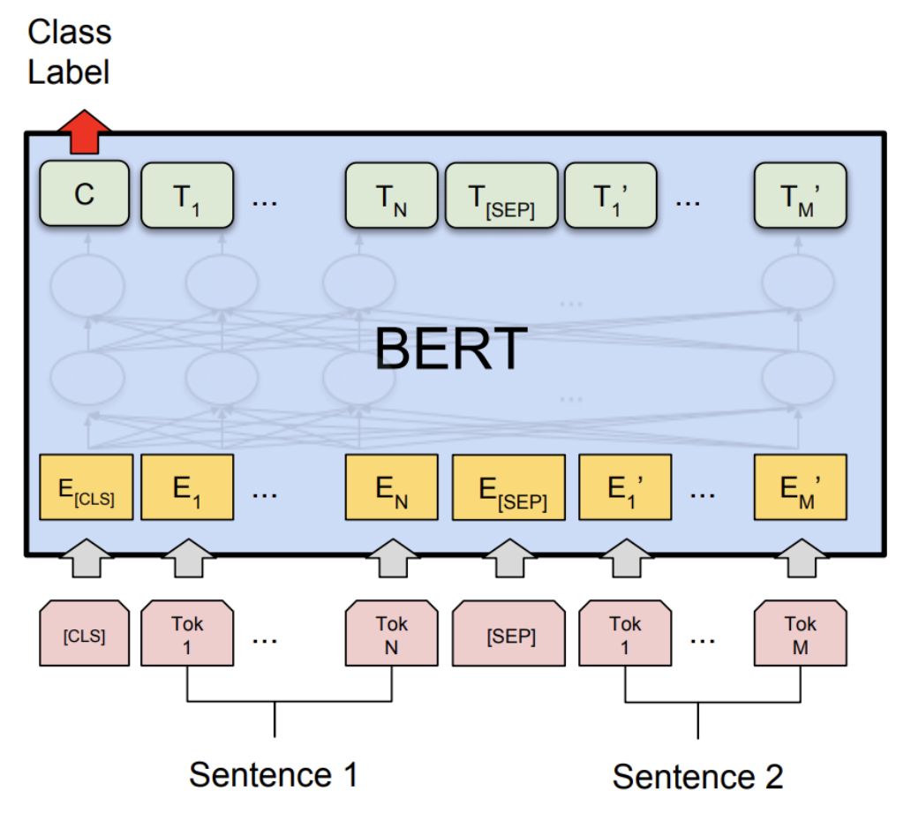
Language Stream: BERT
BERT [6] is developed by Google AI Language
Pretrained deep learning model for natural language processing tasks
Bidirectional, meaning it can consider the full context of a word
Transformer-based architecture, allowing it to learn contextual relations between words
2 special tokens: [CLS] and [SEP]
[CLS] (Classification Token): Represents the whole input sequence and is used for classification tasks. It is added at the beginning of the input sequence.
Each token in the input sequence is represented by a contextualized embedding, which takes into account the entire input sequence and the position of the token in the sequence.
[SEP] (Separator Token): Separates two input sequences in the same input. It is added at the end of each input sequence.
Notes:
FasText trata de capturar la información morfológica de las palabras.
De esta manera, una palabra quedará representada por sus n-gramas. El tamaño de los n-gramas deberá definirse como hiperparámetro:
min_n: el valor mínimo de n a considerar.
max_n: el valor máximo de n a considerar. https://amitness.com/2020/06/fasttext-embeddings/

Slide 8
Implement basic Image-to-text retrieval:
→ Task a: with FastText
→ Task c: with BERT

Slide 9
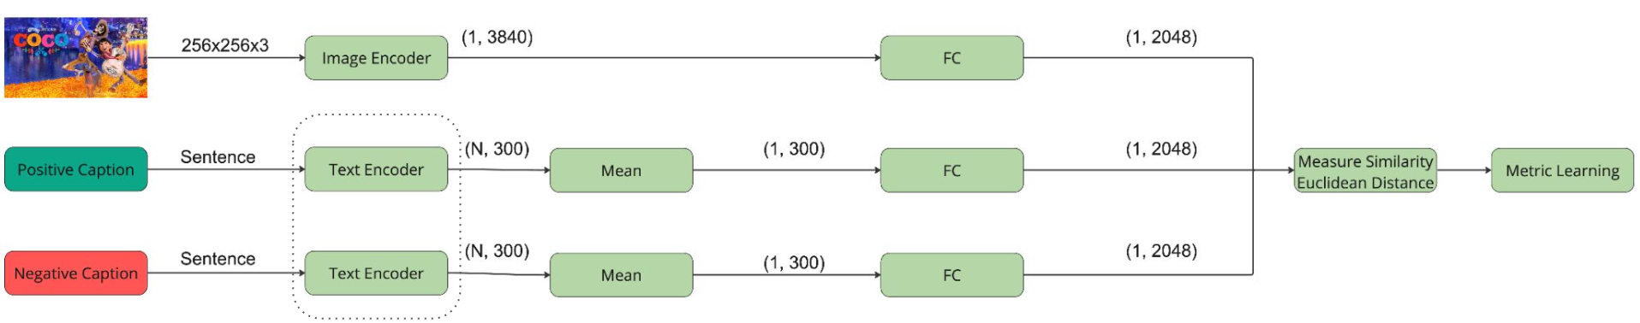

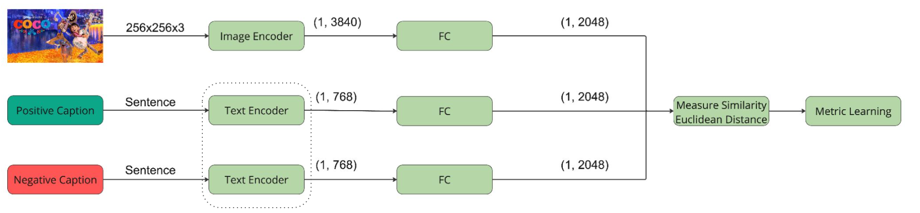
Architectures Image-To-Text
We used the following pipeline with the specified dimensions depending on the text feature extractor.
Anchor
*
Retrieval with
KNN
Captions
Triplet loss
Anchor
*
Retrieval with
KNN
Captions
*
Depends on the architecture. Visual features were extracted from the last convolutional layer of Faster R-CNN (backbone resnet50, pretrained by COCO dataset).

Slide 10
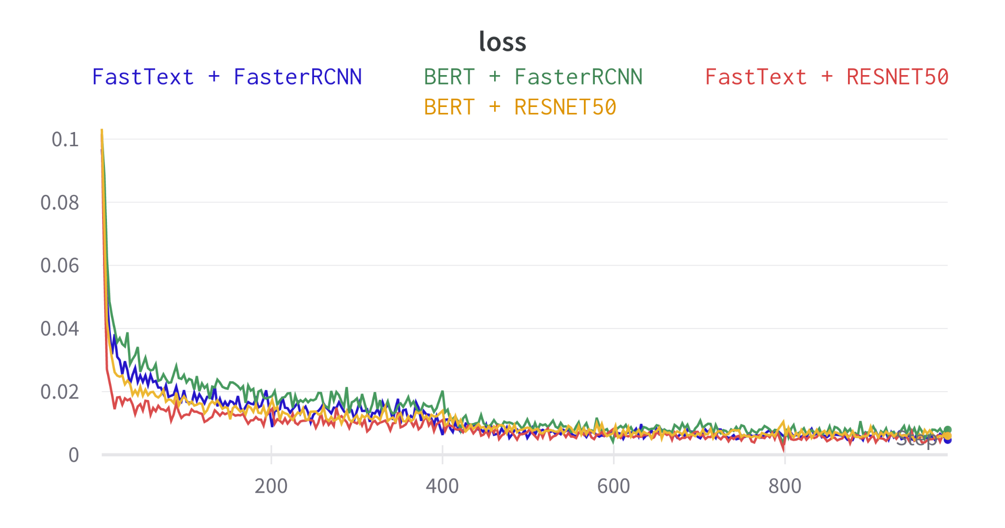
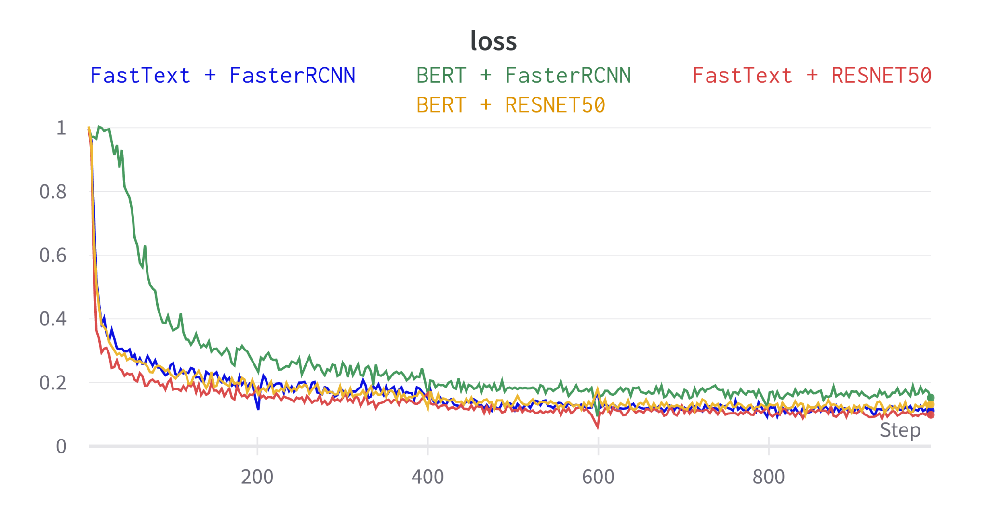
Training Image-To-Text
To train the networks we used the following hyperparameters:
Hyperparameter | Value
Epochs | 5
Learning Rate | 1e-4
LR Scheduler | 2 epochs, gamma 0.1
Batch size | 64
BERT + FasterRCNN convergence is slower than the other models
StepLR scheduler improves our curves losses
Margin 0.1
Margin 1

Slide 11
Results Image-To-Text
Margin 0.1
Margin 1
Samples | Text Embedding | Image Embedder | mAP | Prec@1 | Prec@3 | Prec@5
100 | FastText | RESNET50 | 0.40 | 0.33 | 0.29 | 0.25
 |  | FasterRCNN | 0.34 | 0.25 | 0.24 | 0.21
 | BERT | RESNET50 | 0.35 | 0.25 | 0.23 | 0.22
 |  | FasterRCNN | 0.33 | 0.23 | 0.21 | 0.21
500 | FastText | RESNET50 | 0.26 | 0.17 | 0.16 | 0.14
 |  | FasterRCNN | 0.25 | 0.16 | 0.14 | 0.13
 | BERT | RESNET50 | 0.19 | 0.12 | 0.10 | 0.10
 |  | FasterRCNN | 0.20 | 0.11 | 0.12 | 0.10
1000 | FastText | RESNET50 | 0.21 | 0.14 | 0.14 | 0.14
 |  | FasterRCNN | 0.19 | 0.13 | 0.10 | 0.13
 | BERT | RESNET50 | 0.14 | 0.09 | 0.07 | 0.10
 |  | FasterRCNN | 0.14 | 0.07 | 0.07 | 0.10
Samples | Text Embedding | Image Embedder | mAP | Prec@1 | Prec@3 | Prec@5
100 | FastText | RESNET50 | 0.37 | 0.31 | 0.26 | 0.24
 |  | FasterRCNN | 0.35 | 0.29 | 0.26 | 0.23
 | BERT | RESNET50 | 0.35 | 0.25 | 0.23 | 0.22
 |  | FasterRCNN | 0.29 | 0.23 | 0.19 | 0.17
500 | FastText | RESNET50 | 0.23 | 0.15 | 0.14 | 0.13
 |  | FasterRCNN | 0.22 | 0.14 | 0.14 | 0.13
 | BERT | RESNET50 | 0.19 | 0.12 | 0.10 | 0.10
 |  | FasterRCNN | 0.18 | 0.12 | 0.10 | 0.09
1000 | FastText | RESNET50 | 0.18 | 0.10 | 0.10 | 0.13
 |  | FasterRCNN | 0.16 | 0.09 | 0.09 | 0.13
 | BERT | RESNET50 | 0.14 | 0.09 | 0.07 | 0.10
 |  | FasterRCNN | 0.13 | 0.07 | 0.07 | 0.09
Margin 0.1 yields better results
Results decrease significantly with increased sample size
We continue with margin 0.1

Slide 12
Results Image-To-Text
Margin 0.1
Margin 1
Samples | Text Embedding | Image Embedder | mAP | Prec@1 | Prec@3 | Prec@5
100 | FastText | RESNET50 | 0.40 | 0.33 | 0.29 | 0.25
 |  | FasterRCNN | 0.34 | 0.25 | 0.24 | 0.21
 | BERT | RESNET50 | 0.35 | 0.25 | 0.23 | 0.22
 |  | FasterRCNN | 0.33 | 0.23 | 0.21 | 0.21
500 | FastText | RESNET50 | 0.26 | 0.17 | 0.16 | 0.14
 |  | FasterRCNN | 0.25 | 0.16 | 0.14 | 0.13
 | BERT | RESNET50 | 0.19 | 0.12 | 0.10 | 0.10
 |  | FasterRCNN | 0.20 | 0.11 | 0.12 | 0.10
1000 | FastText | RESNET50 | 0.21 | 0.14 | 0.14 | 0.14
 |  | FasterRCNN | 0.19 | 0.13 | 0.10 | 0.13
 | BERT | RESNET50 | 0.14 | 0.09 | 0.07 | 0.10
 |  | FasterRCNN | 0.14 | 0.07 | 0.07 | 0.10
Samples | Text Embedding | Image Embedder | mAP | Prec@1 | Prec@3 | Prec@5
100 | FastText | RESNET50 | 0.37 | 0.31 | 0.26 | 0.24
 |  | FasterRCNN | 0.35 | 0.29 | 0.26 | 0.23
 | BERT | RESNET50 | 0.35 | 0.25 | 0.23 | 0.22
 |  | FasterRCNN | 0.29 | 0.23 | 0.19 | 0.17
500 | FastText | RESNET50 | 0.23 | 0.15 | 0.14 | 0.13
 |  | FasterRCNN | 0.22 | 0.14 | 0.14 | 0.13
 | BERT | RESNET50 | 0.19 | 0.12 | 0.10 | 0.10
 |  | FasterRCNN | 0.18 | 0.12 | 0.10 | 0.09
1000 | FastText | RESNET50 | 0.18 | 0.10 | 0.10 | 0.13
 |  | FasterRCNN | 0.16 | 0.09 | 0.09 | 0.13
 | BERT | RESNET50 | 0.14 | 0.09 | 0.07 | 0.10
 |  | FasterRCNN | 0.13 | 0.07 | 0.07 | 0.09
Margin 0.1 yields better results
Results decrease significantly with increased sample size
We continue with margin 0.1

Slide 13
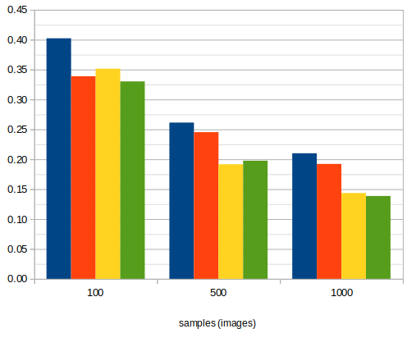
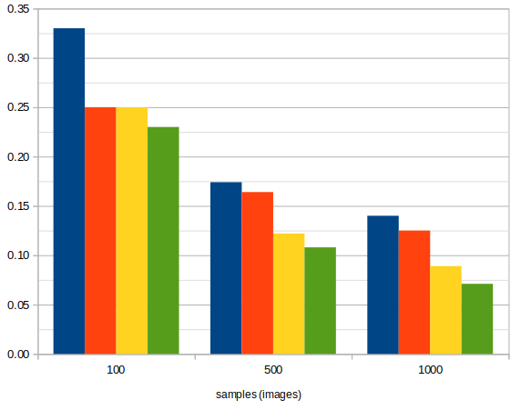
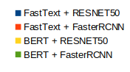
Results with margin 0.1
mAP
Prec@1
We get better results with Resnet50 + FastText.
Increasing number samples decrease the mAP and Prec@k.
FasterRCNN using backbone resnet50 pretrained with COCO 2017 doesn’t help to get better results.
Notes:
Potser n’hi ha overfitting?

Slide 14
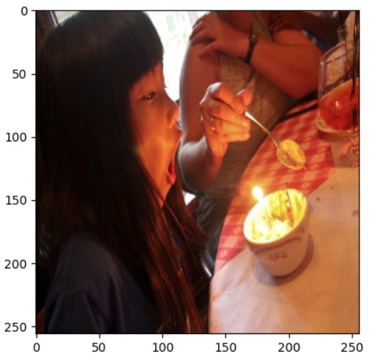
Results Image-To-Text with FastText
Best 5 retrieved Captions in order from most similar to less :
A kid is to blow out the single candle in a bowl of birthday goodness.
Woman eating an assortment of mixed vegetables in a bowl.
A little girl is getting ready to blow out a candle on a small dessert.
Two cooks are cooking the food someone ordered at this restaurant
A woman marking a cake with the back of a chef's knife.
A kid is to blow out the single candle in a bowl of birthday goodness.
Woman eating an assortment of mixed vegetables in a bowl.
A little girl is getting ready to blow out a candle on a small dessert.
Two cooks are cooking the food someone ordered at this restaurant
A woman marking a cake with the back of a chef's knife.
Baby boy at the table eating cake frosting off his hand.
A little girl is preparing food at a table
A boy eating a doughnut and holding a coffee cup
Two children sitting at a table eating food.
Two children are sitting at a table eating food.
Query Image:
Depending on the size of the test the results are quite good (N = 100, N = 500). However, as we increment the test to 1000 samples, the captions are wrong. However, they are more or less related to the image: kids, food, dining table…
Test samples = 100
Test samples = 500
Test samples = 1000

Slide 15
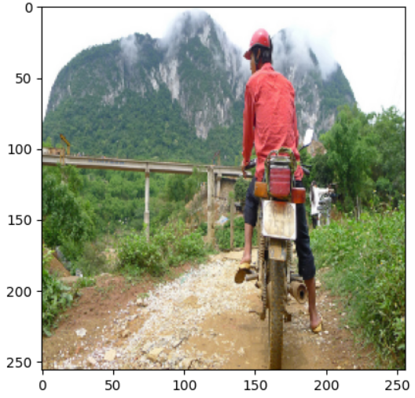
Results Image-To-Text with FastText
Best 5 retrieved Captions in order from most similar to less :
A dirt path with a young person on a motorbike rests to the foreground of a verdant area with a bridge and a background of cloud-wreathed mountains.
A man looking down with a backpack on in a house.
A man riding an elephant in a river.
A man standing over several bunches of green bananas.
A man in a green tie with his eyes closed.
A woman and child playing frisbee in a grassy area.
A woman and a little girl playing with a Frisbee in the sun on a green lawn.
Girl dressed in a scouting uniform standing near a fence with her foot on a small cannon.
A woman holds a blue and a pink umbrella on a foggy day at the beach.
A dirt path with a young person on a motorbike rests to the foreground of a verdant area with a bridge and a background of cloud-wreathed mountains.
Snowboards resting upon a tree, with man hiding inside it like fort
A little girl laughs and runs with a kite in a grassy park.
The man kneeling on the sidewalk is near a yellow structure.
A woman standing in the sand with a kite.
A man in a grassy area with a frisbee.
Query Image:
In this case, the results are much worse. Only one correct caption is retrieved for N= 100 and 500.
Here we also see that increasing the number of samples of the test leads to worse results and the system is not able to retrieve the good captions.
Test samples = 100
Test samples = 500
Test samples = 1000

Slide 16
Results Image-To-Text with BERT
Best 5 retrieved Captions in order from most similar to less :
A group of people prepare dinner in the kitchen.
A table with pies being made and a person standing near a wall with pots and pans hanging on the wall.
A woman cutting a large white sheet cake.
A woman forks vegetables out of a bowl into her mouth.
Two cooks are cooking the food someone ordered at this restaurant
A group of people prepare dinner in the kitchen.
A table with pies being made and a person standing near a wall with pots and pans hanging on the wall.
A woman cutting a large white sheet cake.
A woman forks vegetables out of a bowl into her mouth.
Two cooks are cooking the food someone ordered at this restaurant
A lady sitting at an enormous dining table with lots of food.
A woman standing near a table with plates covered in food.
A man sitting at a table with lots of food in front of him.
Three female workers stand in front of rows of pastries.
Three men all eating sub sandwiches at a restaurant.
Query Image:
In this case we get really bad results. Any of the captions are correct. Note that with the same example with FastText, much more
accurate results were obtained.
Test samples = 100
Test samples = 500
Test samples = 1000

Slide 17
Results Image-To-Text with BERT
Best 5 retrieved Captions in order from most similar to less :
A man in a red shirt and a red hat is on a motorcycle on a hillside.
A man with a red helmet on a small moped on a dirt road.
A lady riding her bicycle on the side of a street.
Man riding a motorbike on a dirt road on the countryside.
A woman rides a bicycle on a road next to the median.
A man wearing a backpack walking along side of a stopped train with train planters with plants in them
A man in a red shirt and a red hat is on a motorcycle on a hillside.
A man towing a wooden wagon down a grass field.
A man with a red helmet on a small moped on a dirt road.
A lady riding her bicycle on the side of a street.
A man wearing a backpack walking along side of a stopped train with train planters with plants in them
A man in a red shirt and a red hat is on a motorcycle on a hillside.
A person on a horse on a dirt field.
A man holding a surfboard next to a fence
A woman riding on the back of a brown horse through a forest.
Query Image:
Contrary to the previous example, in this case BERT leads to better performance of the retrieval than using FastText.
Test samples = 100
Test samples = 500
Test samples = 1000

Slide 18
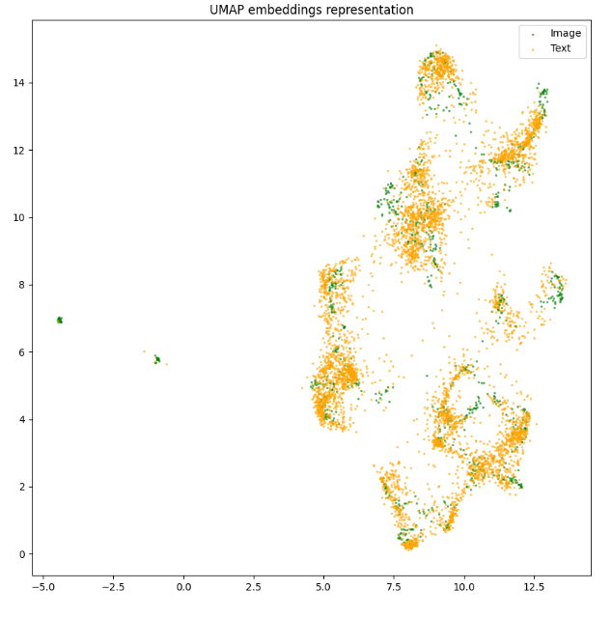
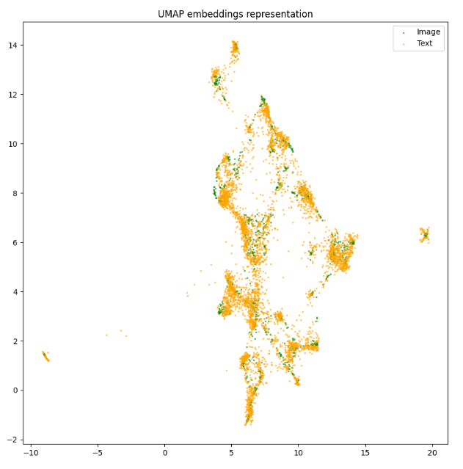
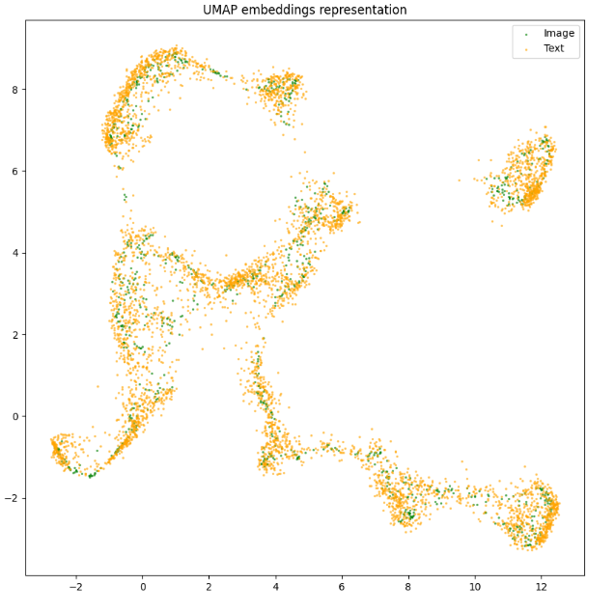
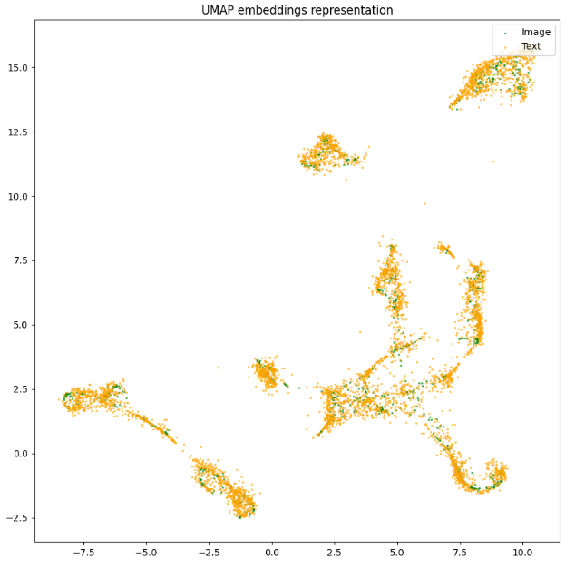
Image-to-Text: Comparison FastText and BERT
FastText 1st epoch
FastText best model
We can see that in the best model, the embeddings image and embeddings test are more superimposed on each other.
BERT 1st epoch
BERT best model
Additionally, BERT and FastText condition the representation of captions differently, which affects the way the image is represented after the metric learning is performed.

Slide 19
Implement basic Text-to-image retrieval:
→ Task b: with FastText
→ Task c: with BERT

Slide 20
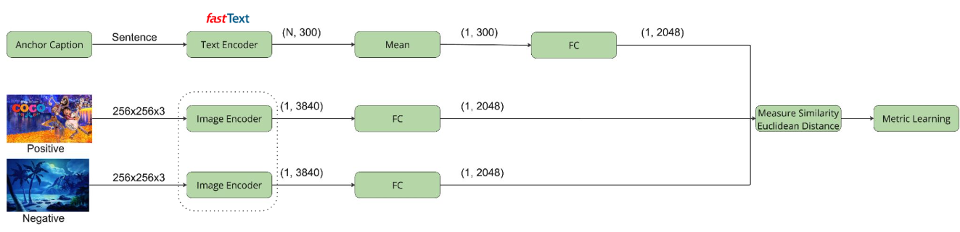

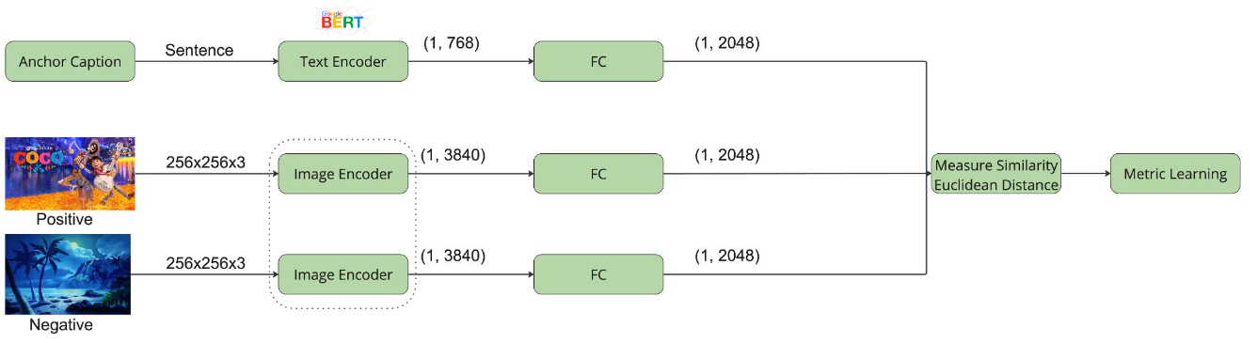
Architecture Text-to-Image with FastText
We used the following pipeline with the specified dimensions depending on the text feature extractor.
Retrieval with
KNN
Images
*
Triplet loss
Retrieval with
KNN
Images
*
*
Depends on the architecture. Visual features were extracted from the last convolutional layer of Faster R-CNN (backbone resnet50, pretrained by COCO dataset).

Slide 21
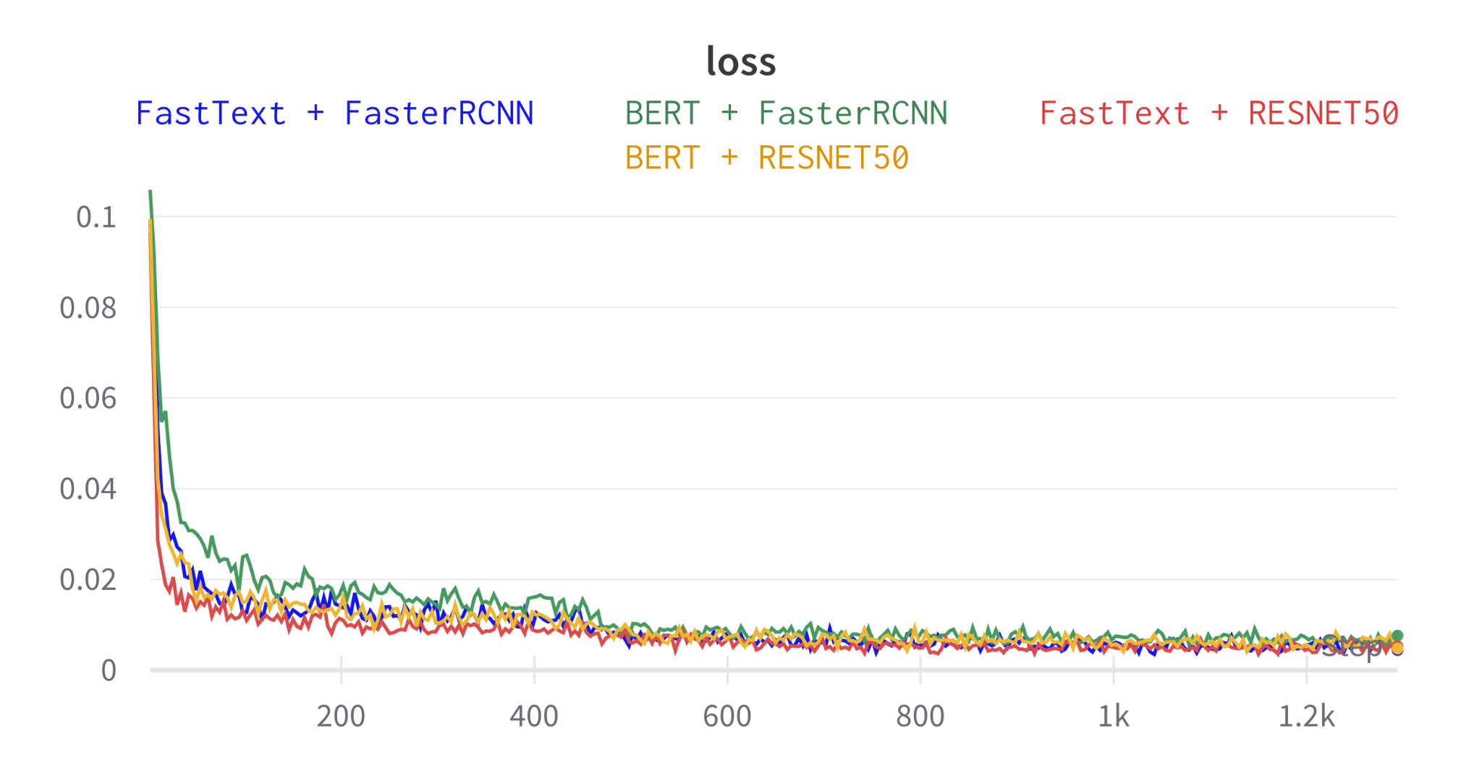
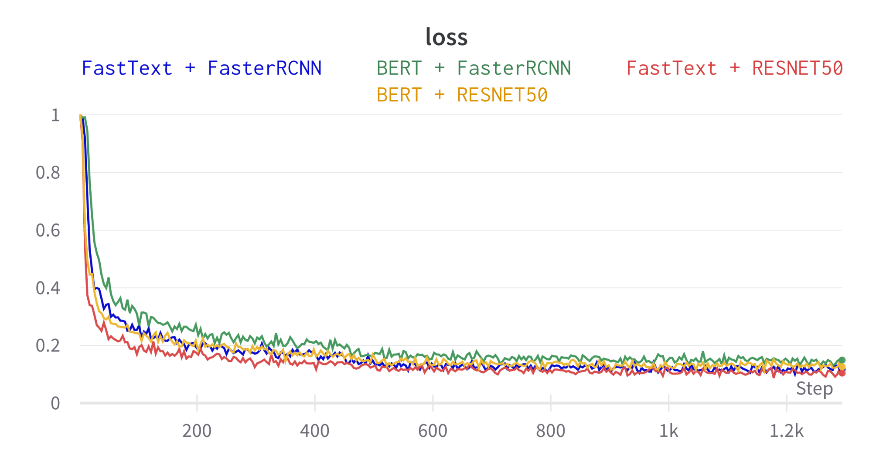
Text-to-Image Training
Hyperparameter | Value
Epochs | 1
Learning Rate | 1e-4
LR Scheduler | 450 steps, gamma 0.1
Batch size | 64
StepLR scheduler improves our curves losses
Margin 0.1
Margin 1

Slide 22
Results Text-to-Image
Margin 0.1
Margin 1
Samples | Text Embedding | Image Embedder | mAP | Top-1 | Top-3 | Top-5
100 | FastText | RESNET50 | 0.39 | 0.27 | 0.50 | 0.59
 |  | FasterRCNN | 0.40 | 0.28 | 0.49 | 0.60
 | BERT | RESNET50 | 0.37 | 0.24 | 0.47 | 0.59
 |  | FasterRCNN | 0.32 | 0.21 | 0.31 | 0.42
500 | FastText | RESNET50 | 0.30 | 0.19 | 0.39 | 0.50
 |  | FasterRCNN | 0.28 | 0.17 | 0.36 | 0.47
 | BERT | RESNET50 | 0.24 | 0.15 | 0.31 | 0.42
 |  | FasterRCNN | 0.20 | 0.12 | 0.26 | 0.36
1000 | FastText | RESNET50 | 0.23 | 0.13 | 0.30 | 0.41
 |  | FasterRCNN | 0.21 | 0.13 | 0.27 | 0.38
 | BERT | RESNET50 | 0.18 | 0.10 | 0.24 | 0.34
 |  | FasterRCNN | 0.14 | 0.07 | 0.18 | 0.26
Samples | Text Embedding | Image Embedder | mAP | Top-1 | Top-3 | Top-5
100 | FastText | RESNET50 | 0.41 | 0.28 | 0.52 | 0.61
 |  | FasterRCNN | 0.37 | 0.25 | 0.48 | 0.58
 | BERT | RESNET50 | 0.36 | 0.24 | 0.46 | 0.58
 |  | FasterRCNN | 0.32 | 0.21 | 0.42 | 0.53
500 | FastText | RESNET50 | 0.29 | 0.18 | 0.37 | 0.47
 |  | FasterRCNN | 0.24 | 0.14 | 0.30 | 0.42
 | BERT | RESNET50 | 0.21 | 0.12 | 0.28 | 0.37
 |  | FasterRCNN | 0.18 | 0.10 | 0.24 | 0.34
1000 | FastText | RESNET50 | 0.21 | 0.12 | 0.27 | 0.37
 |  | FasterRCNN | 0.18 | 0.10 | 0.23 | 0.32
 | BERT | RESNET50 | 0.15 | 0.08 | 0.19 | 0.28
 |  | FasterRCNN | 0.14 | 0.07 | 0.18 | 0.26
In task B we decide to use top accuracy, not Prec@k, as there is only one correct solution.
With 100 samples, margin 1 is better than margin 0.1.
With 500 and 1000 samples, margin 0.1 still performs best.
Good results in Top-5 accuracy, considering the difficulty of the task.
Overall, margin 0.1 is the best choice for both Task A and Task B.

Slide 23
Results Text-to-Image
Margin 0.1
Margin 1
Samples | Text Embedding | Image Embedder | mAP | Top-1 | Top-3 | Top-5
100 | FastText | RESNET50 | 0.39 | 0.27 | 0.50 | 0.59
 |  | FasterRCNN | 0.40 | 0.28 | 0.49 | 0.60
 | BERT | RESNET50 | 0.37 | 0.24 | 0.47 | 0.59
 |  | FasterRCNN | 0.32 | 0.21 | 0.31 | 0.42
500 | FastText | RESNET50 | 0.30 | 0.19 | 0.39 | 0.50
 |  | FasterRCNN | 0.28 | 0.17 | 0.36 | 0.47
 | BERT | RESNET50 | 0.24 | 0.15 | 0.31 | 0.42
 |  | FasterRCNN | 0.20 | 0.12 | 0.26 | 0.36
1000 | FastText | RESNET50 | 0.23 | 0.13 | 0.30 | 0.41
 |  | FasterRCNN | 0.21 | 0.13 | 0.27 | 0.38
 | BERT | RESNET50 | 0.18 | 0.10 | 0.24 | 0.34
 |  | FasterRCNN | 0.14 | 0.07 | 0.18 | 0.26
Samples | Text Embedding | Image Embedder | mAP | Top-1 | Top-3 | Top-5
100 | FastText | RESNET50 | 0.41 | 0.28 | 0.52 | 0.61
 |  | FasterRCNN | 0.37 | 0.25 | 0.48 | 0.58
 | BERT | RESNET50 | 0.36 | 0.24 | 0.46 | 0.58
 |  | FasterRCNN | 0.32 | 0.21 | 0.42 | 0.53
500 | FastText | RESNET50 | 0.29 | 0.18 | 0.37 | 0.47
 |  | FasterRCNN | 0.24 | 0.14 | 0.30 | 0.42
 | BERT | RESNET50 | 0.21 | 0.12 | 0.28 | 0.37
 |  | FasterRCNN | 0.18 | 0.10 | 0.24 | 0.34
1000 | FastText | RESNET50 | 0.21 | 0.12 | 0.27 | 0.37
 |  | FasterRCNN | 0.18 | 0.10 | 0.23 | 0.32
 | BERT | RESNET50 | 0.15 | 0.08 | 0.19 | 0.28
 |  | FasterRCNN | 0.14 | 0.07 | 0.18 | 0.26
In task B we decide to use top accuracy, not Prec@k, as there is only one correct solution.
With 100 samples, margin 1 is better than margin 0.1.
With 500 and 1000 samples, margin 0.1 still performs best.
Good results in Top-5 accuracy, considering the difficulty of the task.
Overall, margin 0.1 is the best choice for both Task A and Task B.

Slide 24
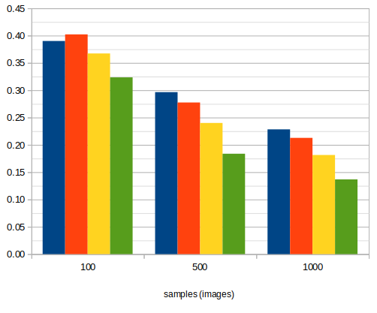
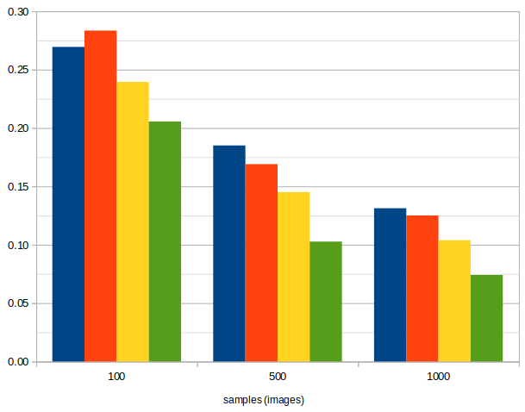
Results Text-to-Image
mAP
Top-1
FastText + FasterRCNN appears to be superior to other models but upon increasing the number of samples, FastText + ResNet50 emerges as the best model
Consistent with findings in Task A
Importance of evaluating models across varying sample sizes
Notes:
Potser n’hi ha overfitting?

Slide 25
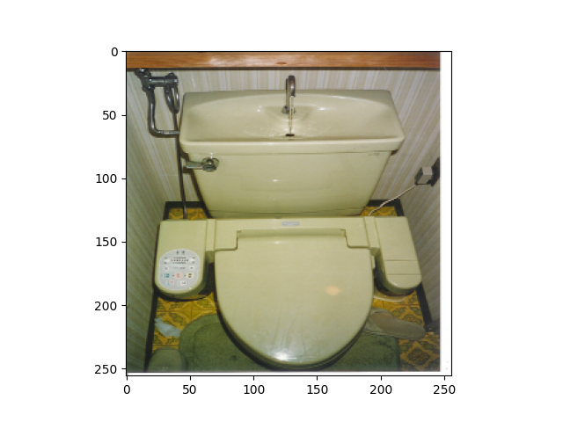
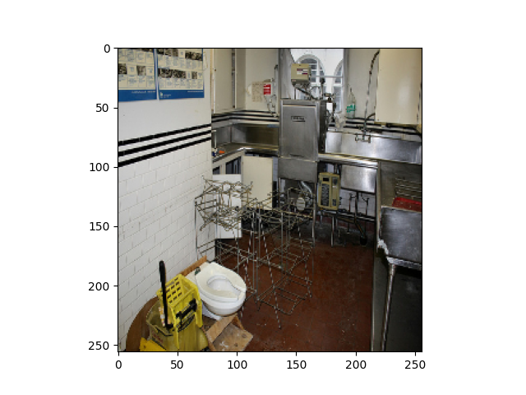
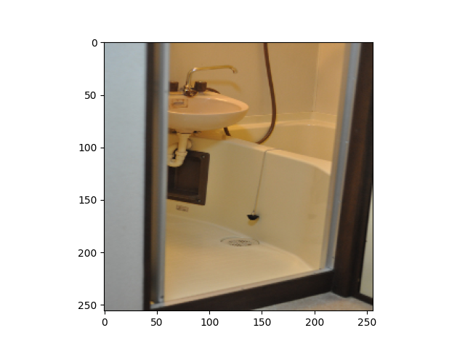
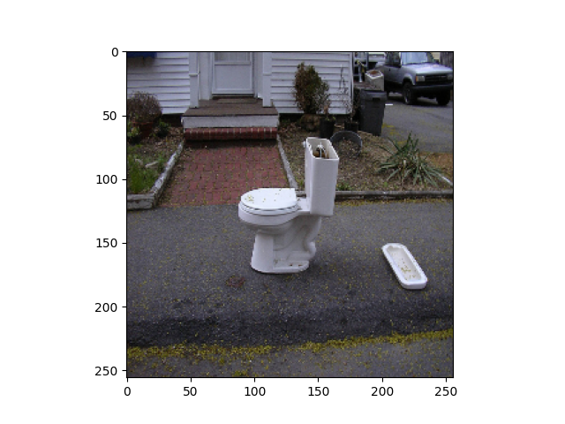
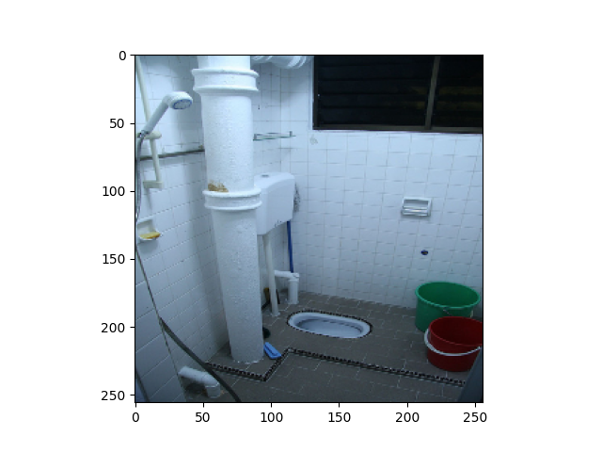
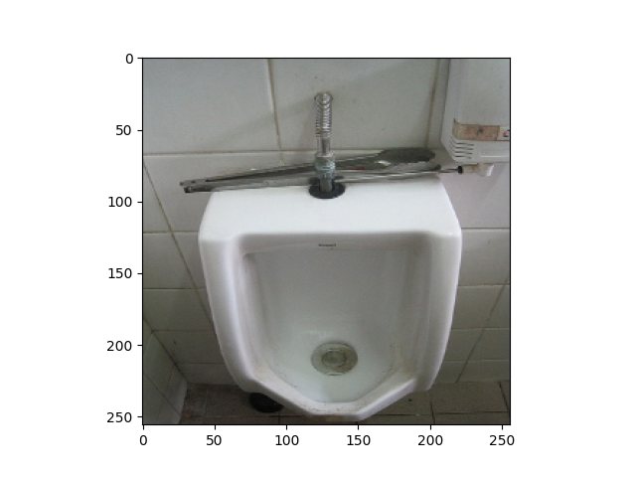
Results Text-to-Image with FastText + Resnet50
GT image:
Qualitative results (GOOD CASE):
Query Caption: A small closed toilet in a cramped space.
Best 5 retrieved images in order from most similar to less (from left to right):
The system is able to retrieve images containing the main word, toilet, and most of the images are also in a cramped space.

Slide 26
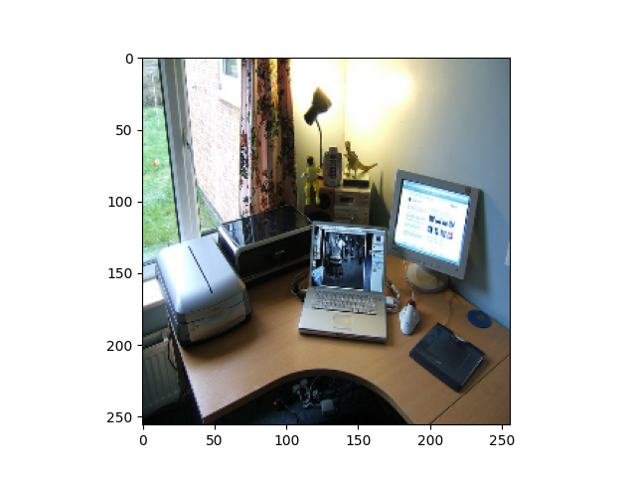
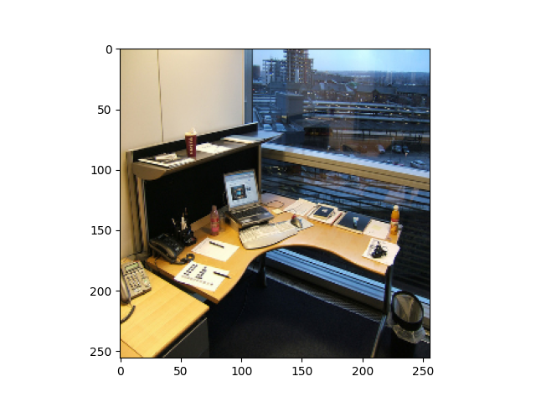
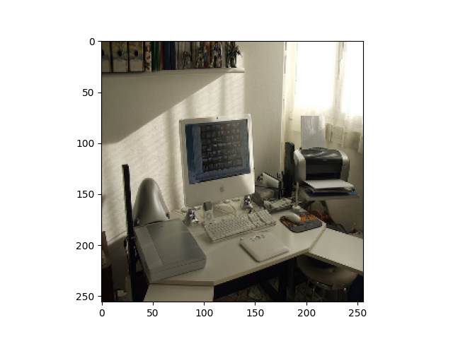
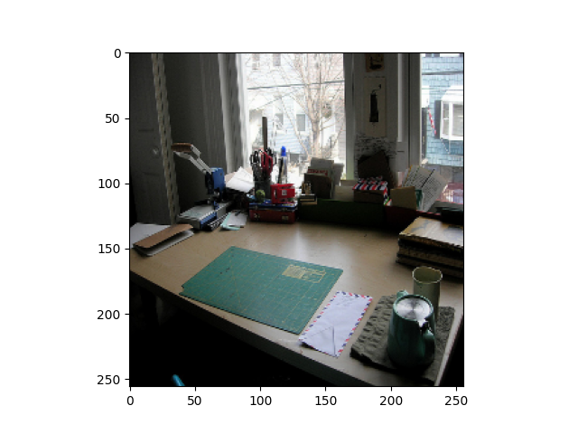
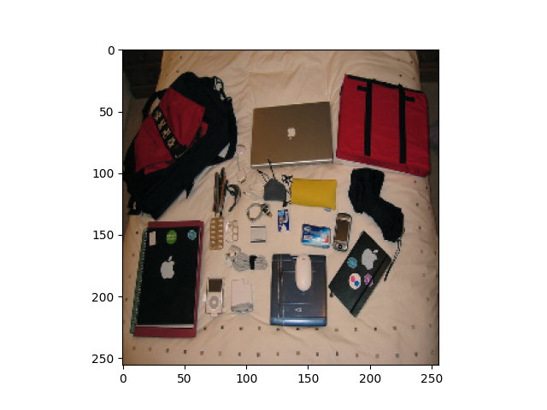
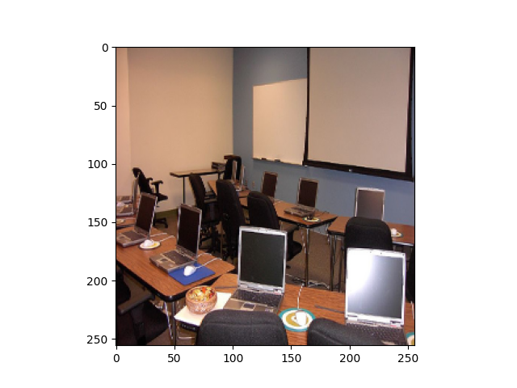
Results Text-to-Image with FastText + Resnet50
GT image:
Qualitative results (BAD CASE):
Query Caption: Office space with office equipment on desktop.
Best 5 retrieved images in order from most similar to less (from left to right):
Using FastText, even the worst case among all the ones we have observed is still quite good, because all the 5 retrieved images contain office equipment. Moreover, the first 3 images are indeed exactly what the caption says, and very similar to the GT image, specially the first retrieved image. The problem is the 4th retrieved image, that contains office equipment but in a bed, not on a desktop.

Slide 27
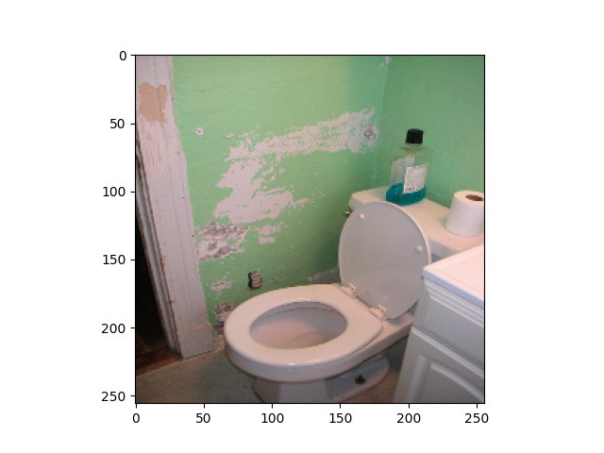
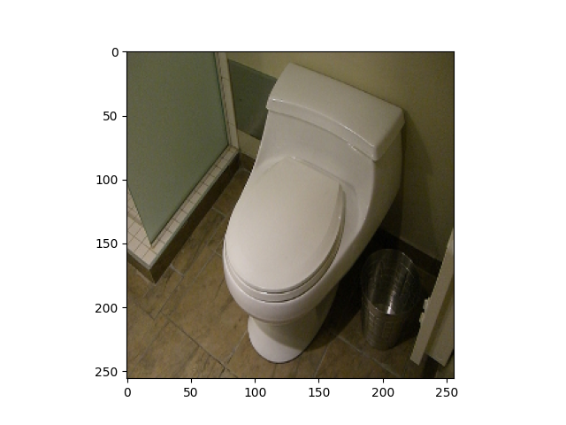
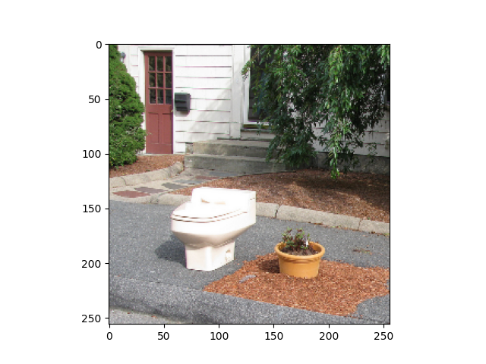
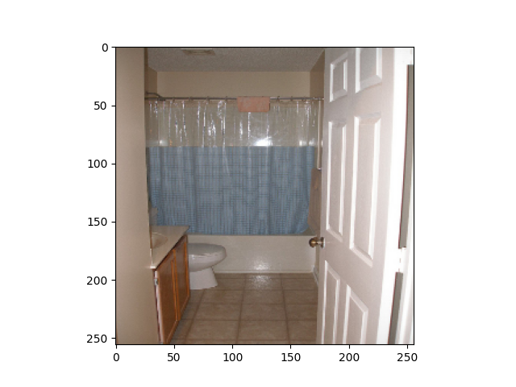
Results Text-to-Image with BERT + Resnet50
GT image:
Qualitative results (GOOD CASE):
Query Caption: A small closed toilet in a cramped space.
Best 5 retrieved images in order from most similar to less (from left to right):
The system is able to retrieve images containing the main word, toilet, and the 3 first images are also in a cramped space.

Slide 28
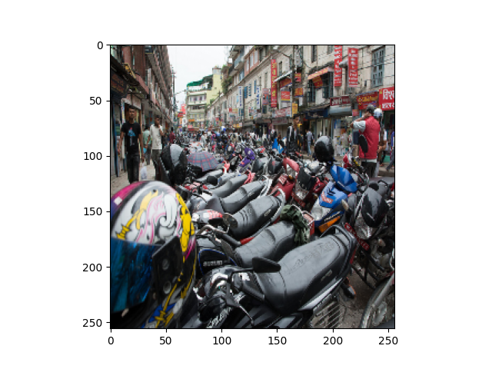
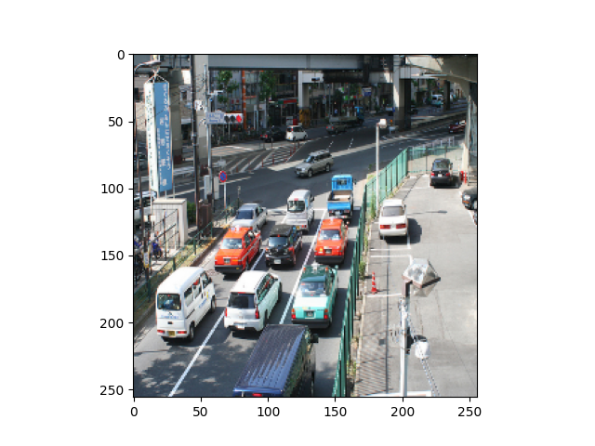
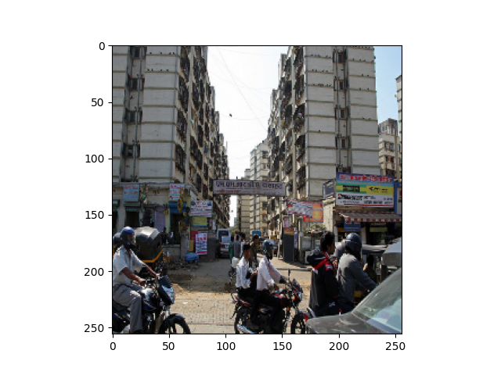
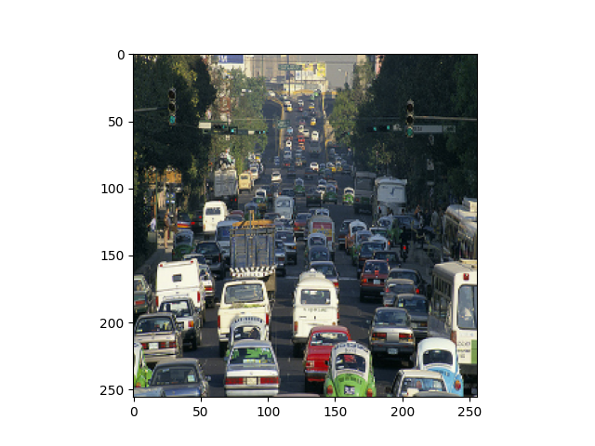
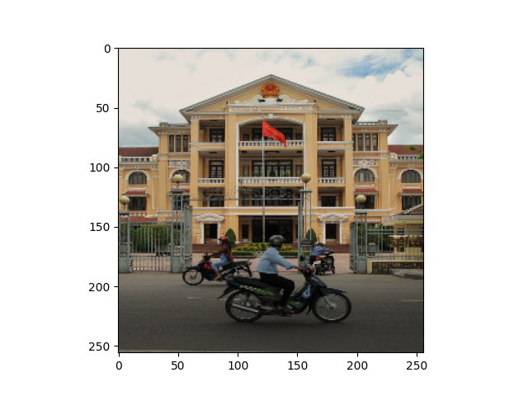
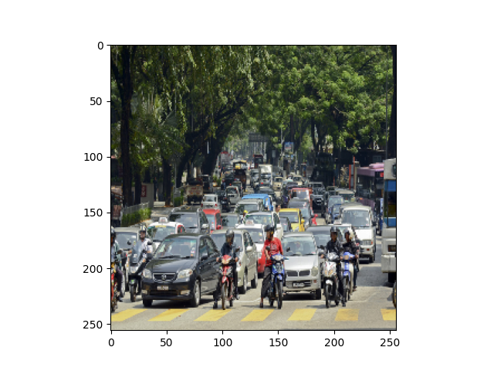
Results Text-to-Image with BERT + Resnet50
GT image:
Qualitative results (BAD CASE):
Query Caption: Rows of motor bikes and helmets in a city.
Best 5 retrieved images in order from most similar to less (from left to right):
In this case the system is able to retrieve images with motor bikes, but also with cars, since they appear together in almost all environments (the city, that is also a word contained in the caption).

Slide 29
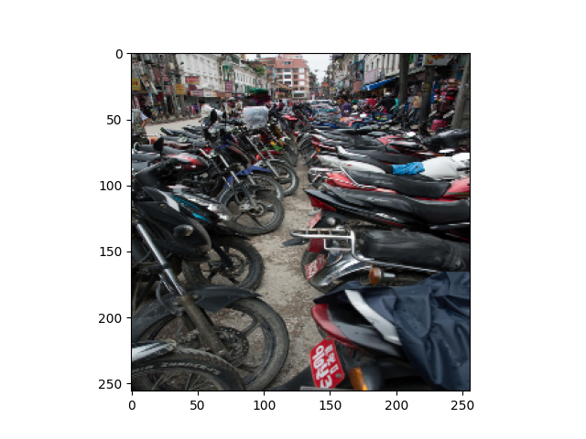
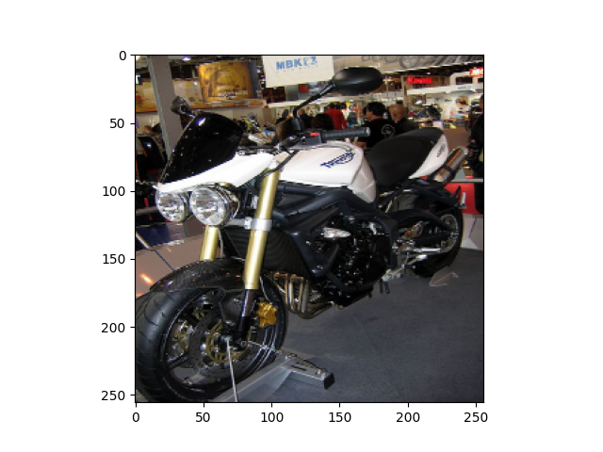
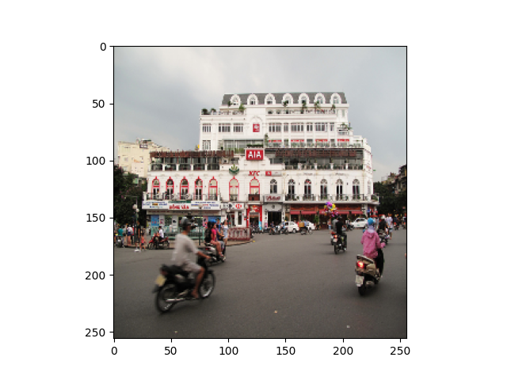
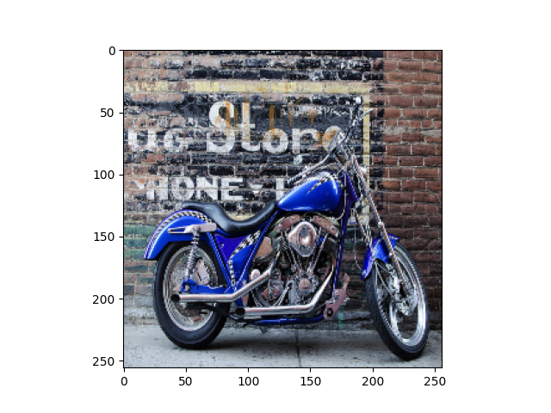
Text-to-Image: Comparison FastText and BERT
GT image:
Query Caption: Rows of motor bikes and helmets in a city.
Best 5 retrieved images in order from most similar to less (from left to right):
FastText
BERT
With FastText we retrieve as first image one that is very similar to the GT. Moreover, the correct GT image is retrieved as third image. With BERT the system has some problems as it retrieves also cars, or traffic environments, not only motor bikes.

Slide 30
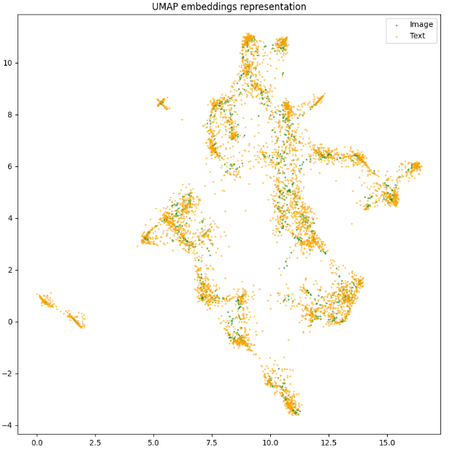

Text-to-Image: Comparison FastText and BERT
FastText 1st epoch
BERT 1st epoch
BERT and FastText condition the representation of captions differently, which affects the way the image is represented after the metric learning is performed.

Slide 31
Conclusions

Slide 32
Conclusions
Cross-modal retrieval is a highly challenging task that requires the integration of both visual and textual information to produce meaningful results.
Utilizing Faster R-CNN with a ResNet-50 backbone, pretrained on the COCO dataset, did not yield significant improvements in performance. This suggests that the model may not be optimally suited for the task or may require further fine-tuning and customization.
The presence of highly similar captions presents a considerable challenge for the model, as it struggles to effectively differentiate between them.
Although BERT was expected to outperform FastText in terms of feature extraction and semantic understanding, it did not produce superior results in this particular task. This could be attributed to the need for additional optimization, task-specific adjustments, or the limitations of BERT itself.
On a qualitative level, the model exhibits satisfactory performance, demonstrating a reasonable understanding of the underlying concepts.
However, quantitative performance deteriorates significantly as the number of samples increases, suggesting a lack of scalability and the need for more robust models or techniques.
Notes:
Task a:
Object detection models such as FasterRCNN and MaskRCNN can struggle with object recognition when textures are similar or when objects are outside their context. FasterRCNN can misclassify objects with similar textures, while MaskRCNN can more accurately detect such objects. However, both models can still correctly detect and label objects outside their context in most cases.
Task b:
When transplanting objects into new images using MaskRCNN, the model is generally able to recognize the transplanted objects, especially for cases such as dogs and clocks. However, in some cases, such as TVs in dark backgrounds, the model may fail to detect the objects. This highlights the importance of background and lighting conditions for object detection.
Task c:
The background of an image plays a critical role in object detection accuracy, and overlapping or partially occluded objects can be challenging for the model. Duplicating objects in an image can provide additional information that can help the model detect and classify objects more accurately, especially if the duplicated object is in a different location or under different lighting conditions than the original object.
Task d:
Feature interference can be harmful to the detection process in MaskRCNN, as features obtained from pixels outside the region of interest can interfere with the predictions. Adding random noise can further amplify this issue. Therefore, it is essential to pay attention to the pixels and features included in the model's training and detection processes.
Task e:
Style transfer can impact object detectability, as some styles may result in texture loss and non-uniform contours, making it more difficult for object detection models to identify objects. It is important to choose styles that preserve object details and contours to minimize the impact on object detection accuracy.

Slide 33
References
Faster R-CNN: "Faster R-CNN: Towards Real-Time Object Detection with Region Proposal Networks" by Ren et al. (2016). Available at: https://arxiv.org/abs/1506.01497
ResNet50: "Deep Residual Learning for Image Recognition" by He et al. (2016). Available at: https://arxiv.org/abs/1512.03385
MS-COCO: "Microsoft COCO: Common Objects in Context" by Lin et al. (2014). Available at: https://arxiv.org/abs/1405.0312
FastText: "Enriching Word Vectors with Subword Information" by Bojanowski et al. (2017). Available at: https://arxiv.org/abs/1607.04606
BERT: "BERT: Pre-training of Deep Bidirectional Transformers for Language Understanding" by Devlin et al. (2018). Available at: https://arxiv.org/abs/1810.04805
ImageNet dataset: "ImageNet: A Large-Scale Hierarchical Image Database" by Deng et al. (2009). Available at: https://ieeexplore.ieee.org/document/5206848
Notes:
Task a:
Object detection models such as FasterRCNN and MaskRCNN can struggle with object recognition when textures are similar or when objects are outside their context. FasterRCNN can misclassify objects with similar textures, while MaskRCNN can more accurately detect such objects. However, both models can still correctly detect and label objects outside their context in most cases.
Task b:
When transplanting objects into new images using MaskRCNN, the model is generally able to recognize the transplanted objects, especially for cases such as dogs and clocks. However, in some cases, such as TVs in dark backgrounds, the model may fail to detect the objects. This highlights the importance of background and lighting conditions for object detection.
Task c:
The background of an image plays a critical role in object detection accuracy, and overlapping or partially occluded objects can be challenging for the model. Duplicating objects in an image can provide additional information that can help the model detect and classify objects more accurately, especially if the duplicated object is in a different location or under different lighting conditions than the original object.
Task d:
Feature interference can be harmful to the detection process in MaskRCNN, as features obtained from pixels outside the region of interest can interfere with the predictions. Adding random noise can further amplify this issue. Therefore, it is essential to pay attention to the pixels and features included in the model's training and detection processes.
Task e:
Style transfer can impact object detectability, as some styles may result in texture loss and non-uniform contours, making it more difficult for object detection models to identify objects. It is important to choose styles that preserve object details and contours to minimize the impact on object detection accuracy.

